Slide 1


ICBD:
Solution Approach Discussion
9th Jan 2026
Notes:
"Good [morning/afternoon], everyone.
It’s a pleasure to be here today to present the proposal from Sigmasoft to Brenntag.
Before we dive into the details, let’s take a moment to reflect on the diversity and innovation that make Brenntag such a leader in its industry.
On the left side of this slide, we’ve showcased some of Brenntag’s key business areas—from sustainable energy solutions and automotive advancements to the food industry, industrial chemicals, personal care, and beyond. These images reflect not just the products and services, but the values and vision that drive Brenntag forward every day.
As a trusted partner, Sigmasoft is excited to collaborate with Brenntag to build on this legacy of excellence. Together, we aim to deliver solutions that empower your team, streamline operations, and drive innovation.
This presentation will outline the tailored solutions we propose, designed to align perfectly with Brenntag’s strategic objectives and commitment to quality.
So, Let’s begin!“ <<slide change>>

Slide 2
Current Information
Data Source | Domain | Auth Method | Middleware | Refresh Frequency
UKG Ready | Human Resources & Workforce Management | API Credentials | Workato (ETL) | Daily
Salesforce | Customer Relationship Management | OAuth 2.0 | Fivetran (ETL) | Every 6 hours
NetSuite | Enterprise Resource Planning (ERP) & Financials | OAuth 2.0 + Cert | Fivetran (ETL) | Paused
Ensora | Behavioral Health & Patient Care Management | API Credentials | Fivetran (ETL) | Every 6 hours
Coupa | Spend Management & Procurement | OAuth 2.0 | Fivetran (ETL) | Paused
Workable | Applicant Tracking System (ATS) & Recruitment | Access Token | Fivetran (ETL) | Paused
CollaborativeMD (CMD) | Medical Practice Management & EMR | API Credentials | POC in Postman | Not Setup
ConnectEMR | Not Available | TBD | TBD | TBD
ConnectRCM | Not Available | TBD | TBD | TBD

Slide 3




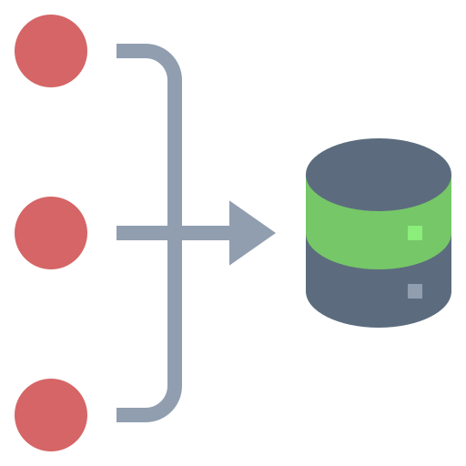





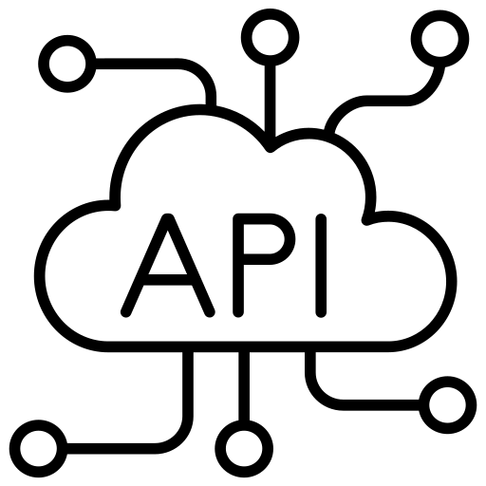















Enterprise Data Flow Framework
Data Sources
AI/BI Mart
Reporting Layer
Middleware
Connection Type
Rest API
OAuth 2.0
AI/ML Model
Data Refresh
Tables
ODBC
Credentials
Views

Slide 4
Few Doubts to progress Further
Is the data in Snowflake already processed or do we need to clean and process for PoC?
Three of our data sources have paused syncs (Coupa, Workable, NetSuite). When were these paused and why?
How should we reconcile Salesforce CONTACT/ACCOUNT data with UKG EMPLOYEE data?
How should Coupa procurement data integrate with NetSuite financials?
Which reports or dashboards are most critical to business operations today?
How much historical data do you need? Should we archive older records?
Can we get data dictionaries or field definitions for each source system?
Who monitors Fivetran sync errors today? How are failures handled?

